Slide 1
Audio signals course project
Machine learning applied to audio signals:
HOW TO RECOGNIZE SOURCE SIGNAL FROM NOISE
Ganassa andrea – 884791
Uboldi daniele – 874996

Slide 2
Index
Goals of the project
Some theory tips
Delay and sum
Implementation
Results and conclusions

Slide 3
Goals of the project
In our project we want to build a ML model able to distinguish a certain type of source signal from a challenging noise signal. We used Random Forest algorithm.
We want, also, demonstrate the improvement of the same model with pre-processed signal in input showing that this would help the classification.

Slide 4

Theory tips: near field delay & sum
Due to the arrangement of the sources and of the array in our case, we used a slightly different formulation of the delay & sum algorithm suited to the near field approximation.
To build the filter we used the following steps:
Steering array $h= \frac{e^{−j2πfdist/c}}{4πdist}$
Filter $H=\frac{h}{h^{H}∗h}$

Slide 5
Implementation: introduction step
Recording the source signal (a door signal in our case) with a 16 microphones array.
Recording the noise signal with the same array.
Determine certain features used to train the model using MirToolBox.

Slide 6
Implementation: model step
Using a single microphone signal (both source and noise) train the model (code) and then test it with another recorded signal from the same microphone.
Calculate the accuracy of the test phase comparing the prediction (code) of the model with a ground truth calculated before.

Slide 7
Implementation: delay & sum step
Process the input signals using those from all the 16 microphones combining them together with an implementation of the delay & sum algorithm;
This algorithm is used to compensate the phase shifts of each sound wave w.r.t. a chosen one (in our case the centre of the array);
The desired result is similar to the beamforming with an attenuation of the noise signal, compared to the sound signal, because its source has been located in a different direction w.r.t. the sound one.

Slide 8
Implementation: improved accuracy step
Change the input for the test phase of the model previoulsy built using the processed signals;
Calculate the accuracy showing the improvement respect to the case without the beamforming.

Slide 9
Results and conclusions pt. 1
The accuracy obtained in our project is shown below: it is clear that the processing of the two signals has worked well and helped improving the performance.
However the percentage still not be of the 100% so, in our opinion, it might be possible to improve the performance using different features from MirToolbox or using a different tool to extract them.
Accuracy (pre BF) | 61,7380 % | Accuracy (post BF) | 93,0214%

Slide 10

Results and conclusions pt. 2: audio demo
Train sound: only one microphone with source signal.
Train noise: only one microphone with noise signal.
Test noise:
Test sound without beamforming:
Test sound with beamforming:

Slide 11
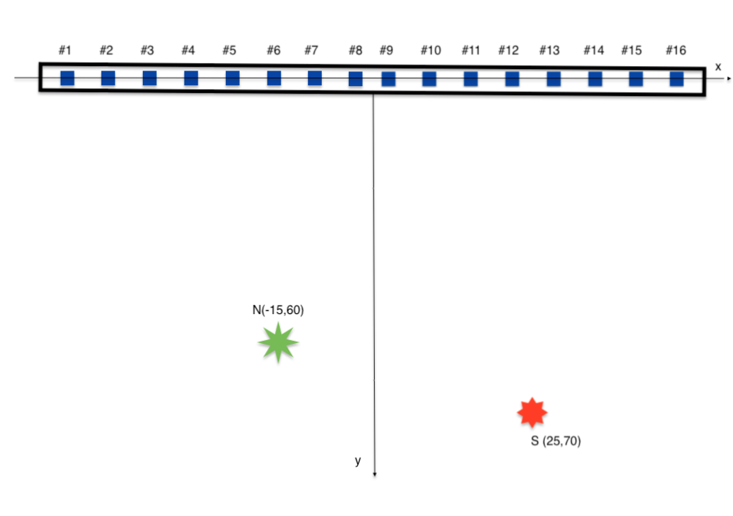
Scheme

Slide 12
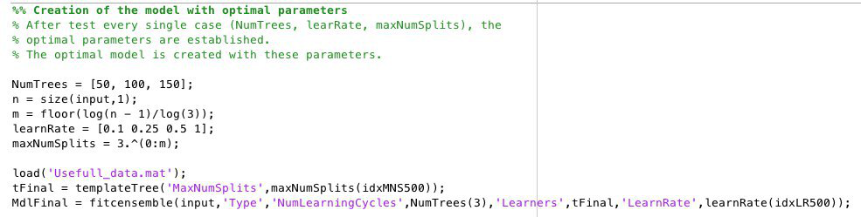
Train of the model

Slide 13
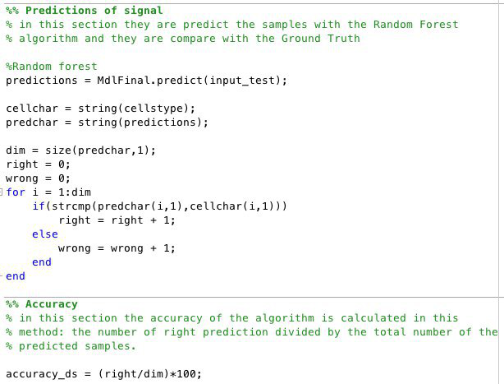
Prediction phase

